Slide 1
Murach’s C# (8th Edition)
Chapter 3
How to code and test a Windows Forms app

Slide 2
Objectives
Applied
Given the code for a simple app, use the skills presented in this chapter to add the code and test the app.
Use indentation and blank lines to make the code easier to read.
Use comments to document the code for the entire form or for portions of the code.
Use any of the help features to get the information that you need for developing an app.

Slide 3
Objectives (continued)
Knowledge
In the context of object-oriented programming, describe these terms: class, object, instantiation, instance, property, method, event, and member.
Describe how an application responds to events.
Describe the use of snippets and refactoring.
Distinguish between a syntax (or build) error and a runtime error.
Distinguish between testing and debugging.
Explain how a data tip can help debug a runtime error.

Slide 4
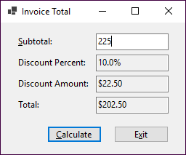
A form object and its ten control objects

Slide 5
Class and object concepts
An object is a self-contained unit like a form or control that combines code and data.
A class is the code that defines the characteristics of an object. You can think of a class as a template for an object.
An object is an instance of a class, and the process of creating an object from a class is called instantiation.
More than one object can be created from a single class.

Slide 6
Property, method, and event concepts
Properties define the characteristics of an object and the data associated with an object.
Methods are the operations that an object can perform.
Events are signals sent by an object to the app telling it that something has happened that can be responded to.
Properties, methods, and events can be referred to as members of an object.
If you instantiate two or more instances of the same class, all of the objects have the same properties, methods, and events.

Slide 7
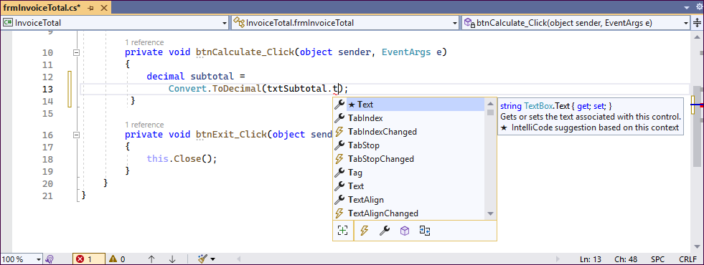
A member list in the Code Editor window

Slide 8
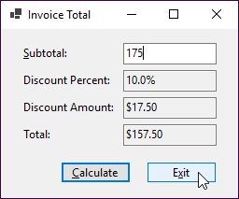
An event: The user clicks the Exit button

Slide 9
The wiring and response
Wiring: The event is connected to a method
btnExit.Click += btnExit_Click;
Response: The method is executed
private void btnExit_Click(
object sender, System.EventArgs e)
{
this.Close();
}

Slide 10
Common control and form events
Control events
Click
DoubleClick
Enter
Leave
Form events
Load
Closing
Closed

Slide 11
How an application responds to events
To indicate how an app should respond to an event, you code an event handler.
To connect the event handler to the event, Visual Studio wires the event to the event handler. This is known as event wiring.

Slide 12
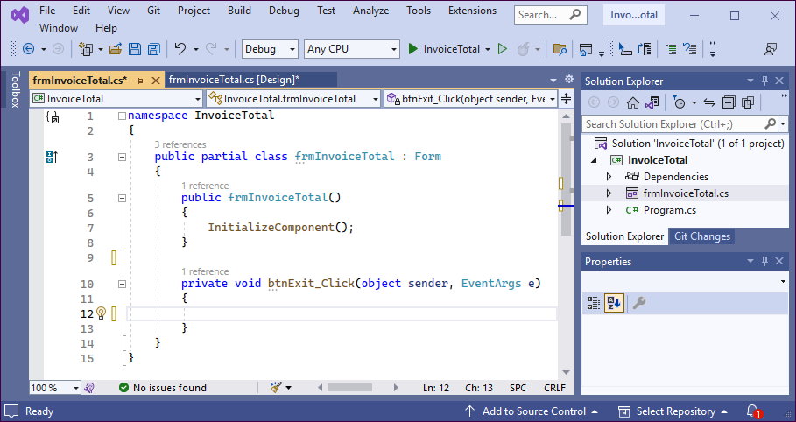
The method that handles the Click event of the Exit button

Slide 13
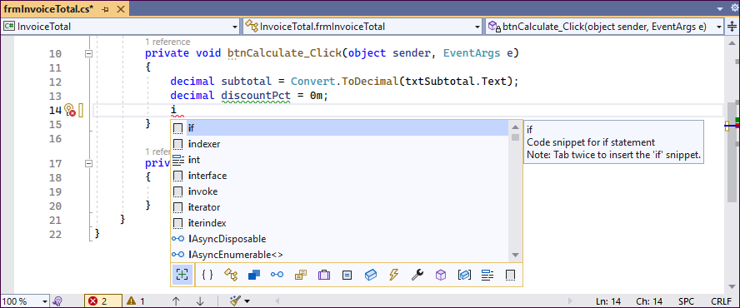
The completion list that’s displayed when you enter a letter at the beginning of a line of code

Slide 14
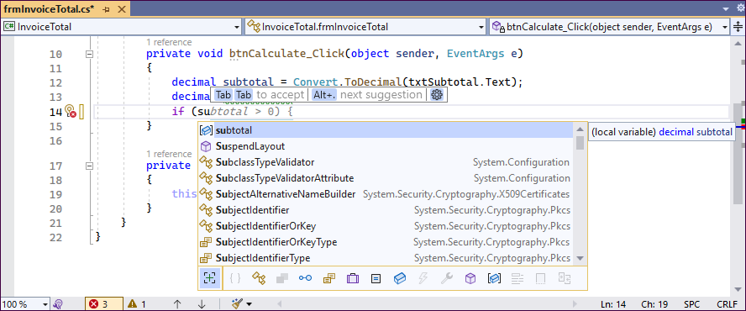
The completion list that’s displayed as you enter code within a statement

Slide 15
The event handlers for the Invoice Total form
private void btnCalculate_Click(object sender, EventArgs e)
{
decimal subtotal =
Convert.ToDecimal(txtSubtotal.Text);
decimal discountPct = 0m;
if (subtotal >= 500)
{
discountPct = .2m;
}
else if (subtotal >= 250 && subtotal < 500)
{
discountPct = .15m;
}
else if (subtotal >= 100 && subtotal < 250)
{
discountPct = .1m;
}

Slide 16
The event handlers for the Invoice Total form (continued)
decimal discountAmt = subtotal * discountPct;
decimal invoiceTotal = subtotal - discountAmt;
txtDiscountPct.Text = discountPct.ToString("p1");
txtDiscountAmt.Text = discountAmt.ToString("c");
txtTotal.Text = invoiceTotal.ToString("c");
txtSubtotal.Focus();
}
private void btnExit_Click(object sender, EventArgs e)
{
this.Close();
}

Slide 17
Coding rules
Use spaces to separate the words in each statement.
Use exact capitalization for all keywords, class names, object names, variable names, etc.
End each statement with a semicolon.
Each block of code must be enclosed in braces ({}). That includes the block of code that defines the body of a method.

Slide 18
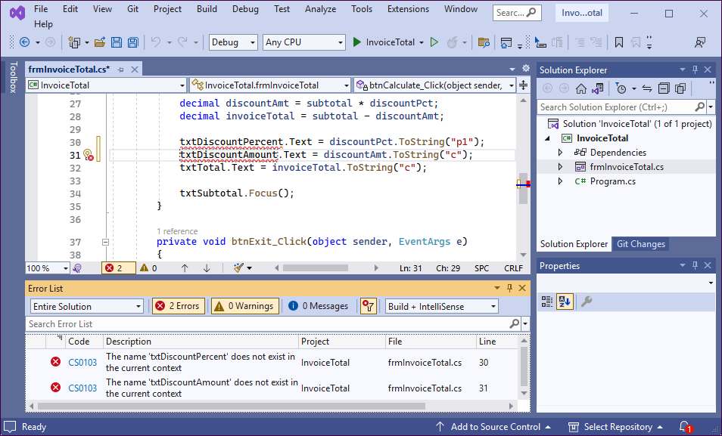
The Code Editor and Error List windows with syntax errors displayed

Slide 19
A method written in a readable style
private void btnCalculate_Click(object sender, EventArgs e)
{
decimal subtotal =
Convert.ToDecimal(txtSubtotal.Text);
decimal discountPct = 0m;
if (subtotal >= 500)
{
discountPct = .2m;
}
else if (subtotal >= 250 && subtotal < 500)
{
discountPct = .15m;
}
else if (subtotal >= 100 && subtotal < 250)
{
discountPct = .1m;
}

Slide 20
A method written in a readable style (continued)
decimal discountAmt = subtotal * discountPct;
decimal invoiceTotal = subtotal - discountAmt;
txtDiscountPct.Text = discountPct.ToString("p1");
txtDiscountAmt.Text = discountAmt.ToString("c");
txtTotal.Text = invoiceTotal.ToString("c");
txtSubtotal.Focus();
}

Slide 21
Coding recommendations
Use indentation and extra spaces to align statements and blocks of code so they reflect the structure of the app.
Use spaces to separate the words, operators, and values in each statement.
Use blank lines before and after groups of related statements.

Slide 22
A method with comments
private void btnCalculate_Click(object sender, EventArgs e)
{
/***************************************
* this method calculates the total
* for an invoice depending on a
* discount that's based on the subtotal
****************************************/
// get the subtotal amount from the Subtotal text box
decimal subtotal = Convert.ToDecimal(txtSubtotal.Text);
// set the discountPct variable based
// on the value of the subtotal variable
decimal discountPct = 0m; // the m indicates a decimal value
if (subtotal >= 500)
{
discountPct = .2m;
}
else if (subtotal >= 250 && subtotal < 500)
{
discountPct = .15m;
}

Slide 23
A method with comments (continued)
else if (subtotal >= 100 && subtotal < 250)
{
discountPct = .1m;
}
// calculate and assign the values for the
// discountAmt and invoiceTotal variables
decimal discountAmt = subtotal * discountPct;
decimal invoiceTotal = subtotal - discountAmt;
// format the values and display them in their text boxes
txtDiscountPct.Text = // percent format
discountPct.ToString("p1"); // with 1 decimal place
txtDiscountAmt.Text =
discountAmt.ToString("c"); // currency format
txtTotal.Text =
invoiceTotal.ToString("c");
// move the focus to the Subtotal text box
txtSubtotal.Focus();
}

Slide 24
How to code comments
To code a single-line comment, type // before the comment.
To code a delimited comment, type /* at the start of the comment and */ at the end.

Slide 25
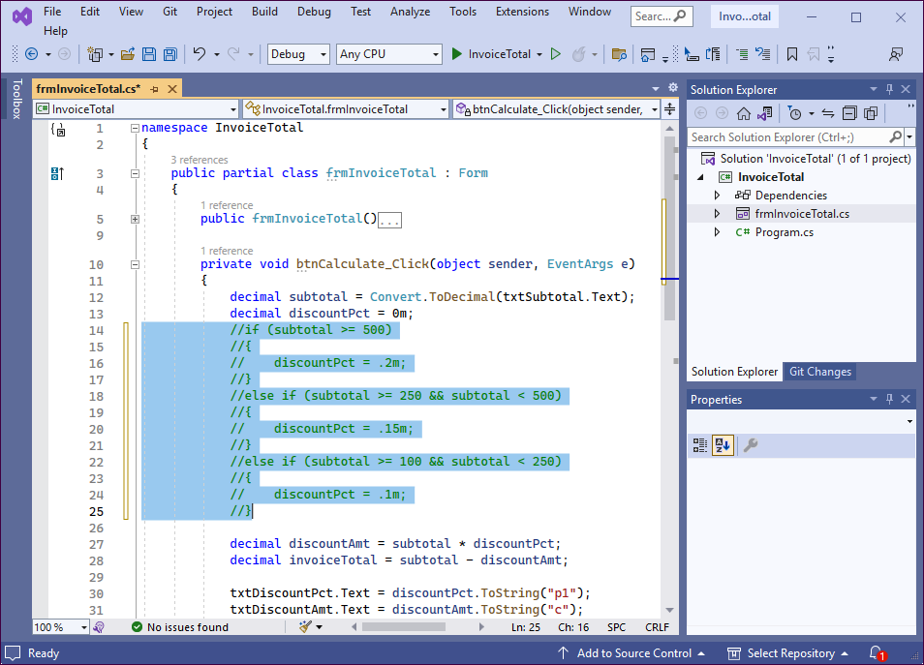
The Code Editor and the Text Editor toolbar

Slide 26
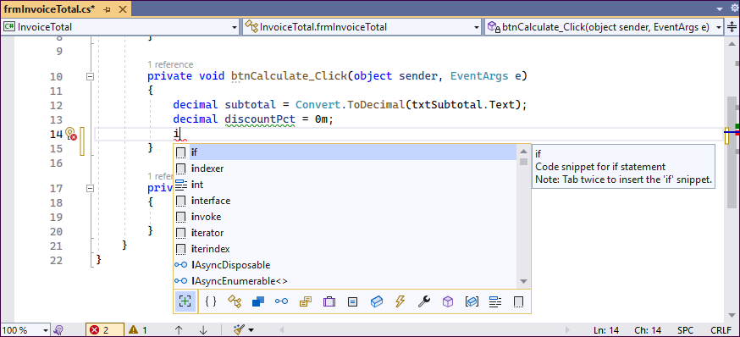
The completion list for the if keyword

Slide 27
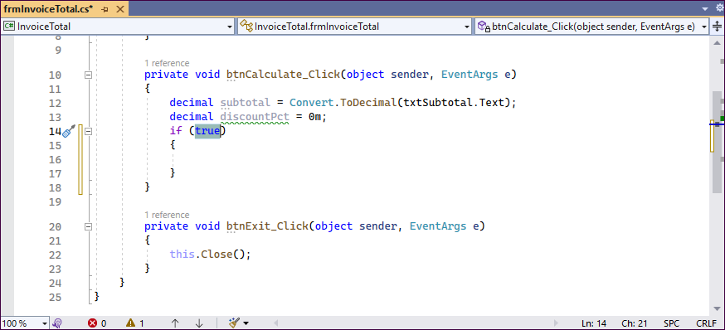
The if snippet after it has been inserted

Slide 28
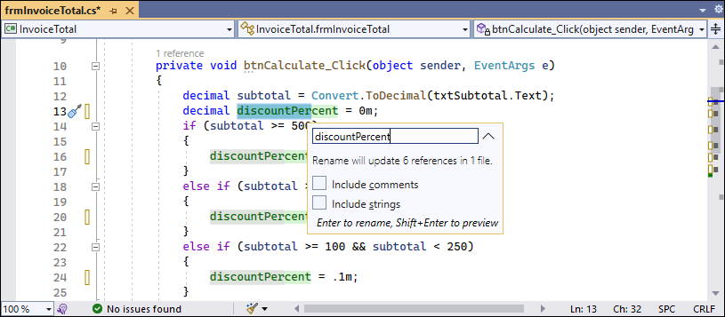
The options when you rename a variable

Slide 29
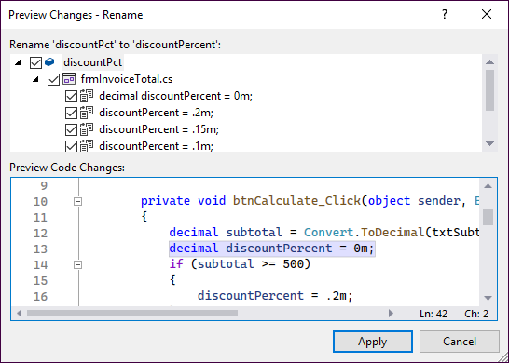
The Preview Changes - Rename dialog

Slide 30
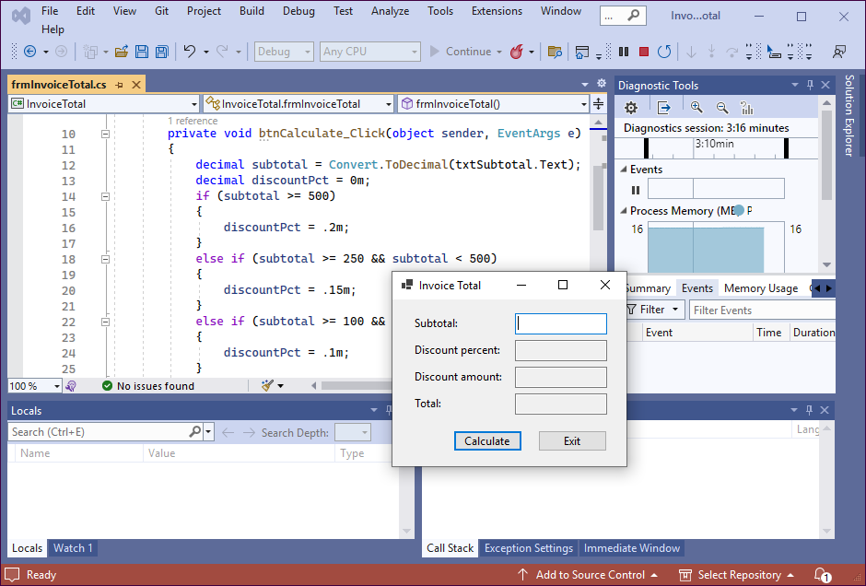
The form that’s displayed when you run the Invoice Total project

Slide 31
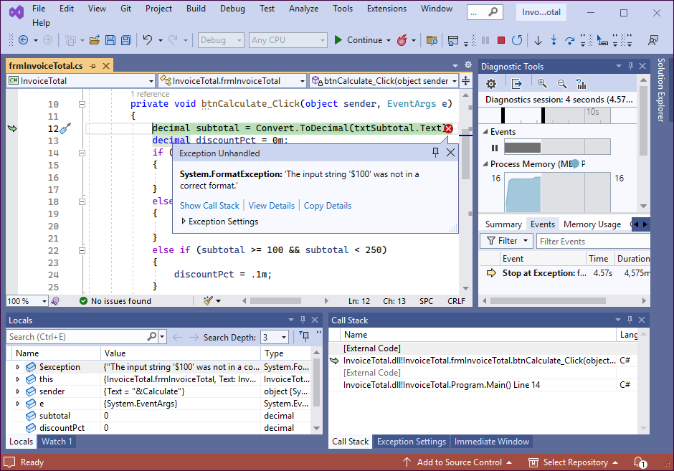
The Exception Helper that’s displayed when a runtime error occurs

Slide 32
How to test a project
Test the user interface, including the appearance of the controls, the tab order, the access keys, and the Enter and Esc keys.
Test valid input data.
Test invalid data or unexpected user actions.

Slide 33
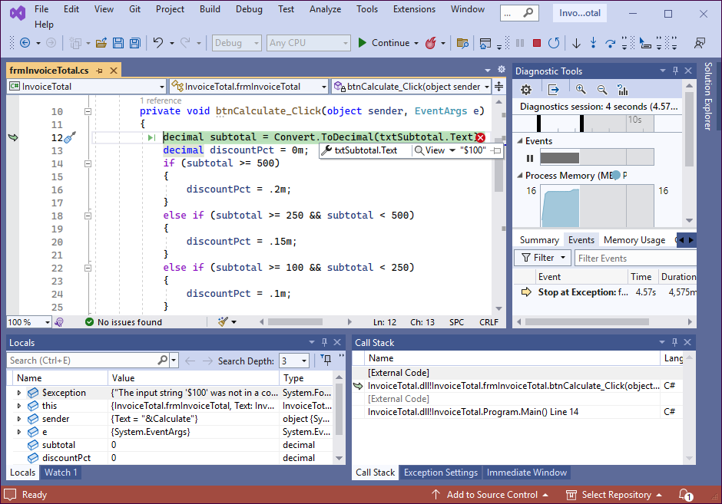
How a project looks in break mode

